Slide 1
Microsoft - New Horizons
A detailed analysis of the International Movie Industry

Slide 2

Probing Questions
Competition:
Which production companies make the most movies?
Which production companies make the highest grossing movies on average?
Genres:
Which genres are most oversaturated?
Which genres return the highest profit?
Release Month:
Which months are most movies released?
Runtime:
What is the optimal runtime for the highest grossing genres?

Slide 3
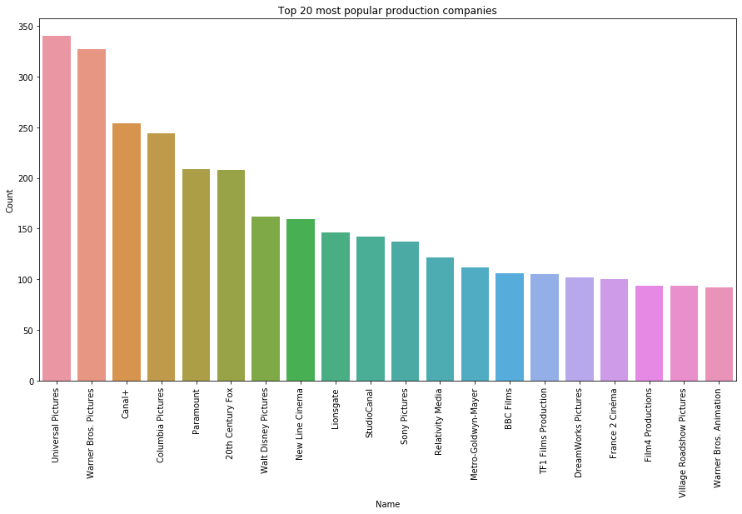
Competition: Which Production Companies create the most movies?

Slide 4
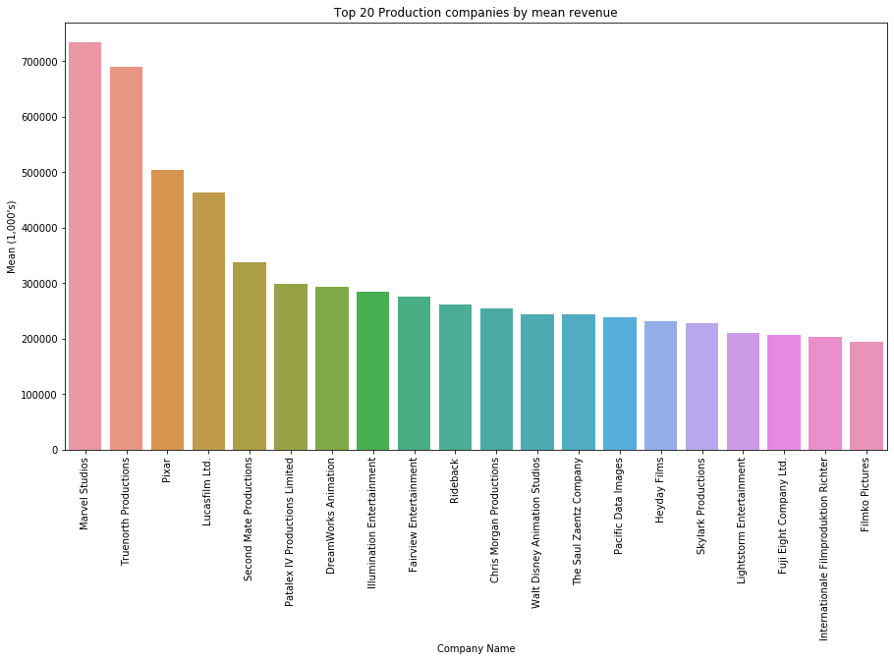
Competition: Which Production Companies create the highest-grossing movies?

Slide 5
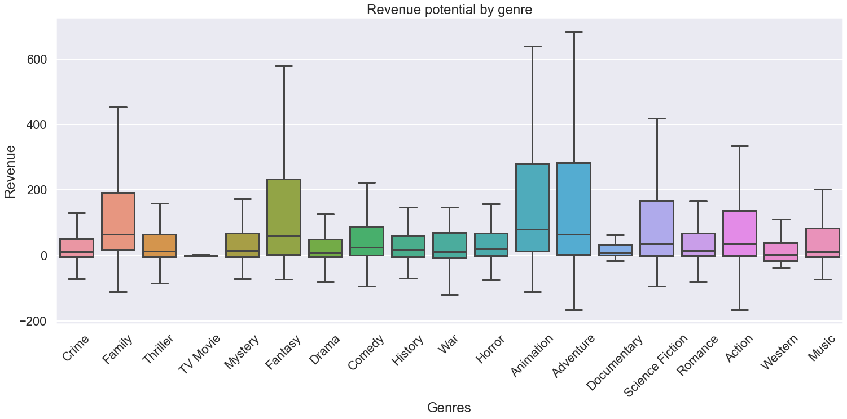
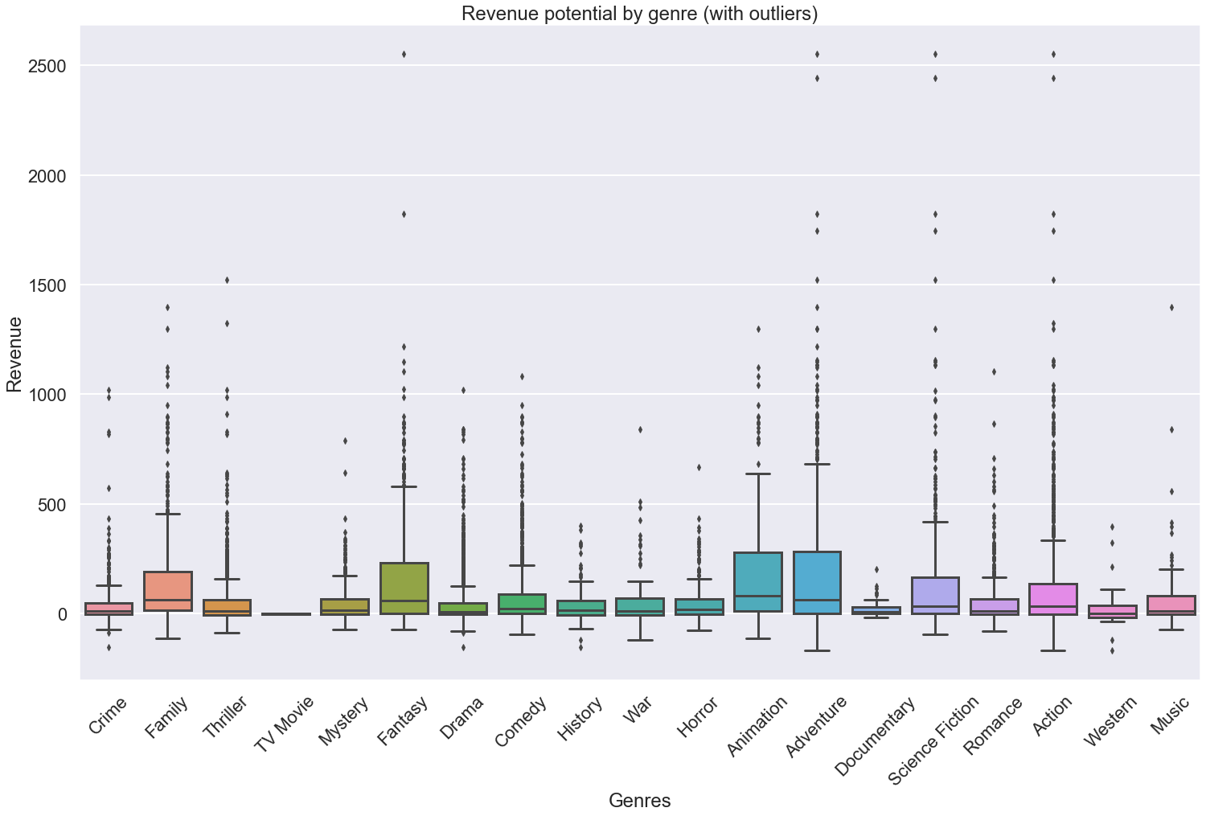
Genres: Fantasy, Animation, and Adventure return the highest profit

Slide 6
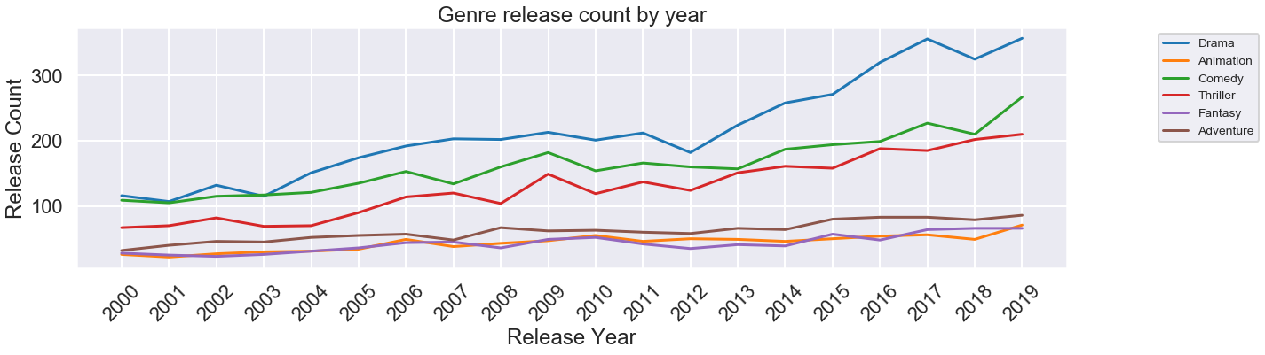
Genres: Drama, Comedy, and Thrillers are oversaturated

Slide 7
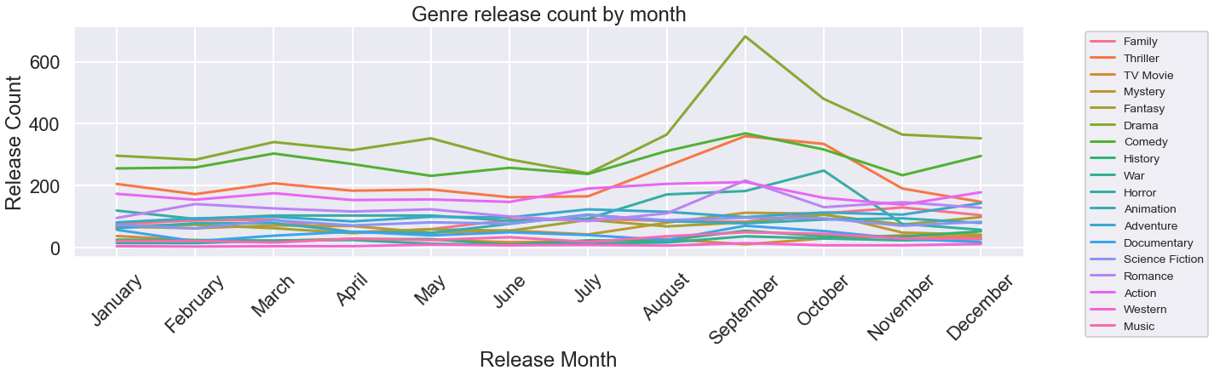
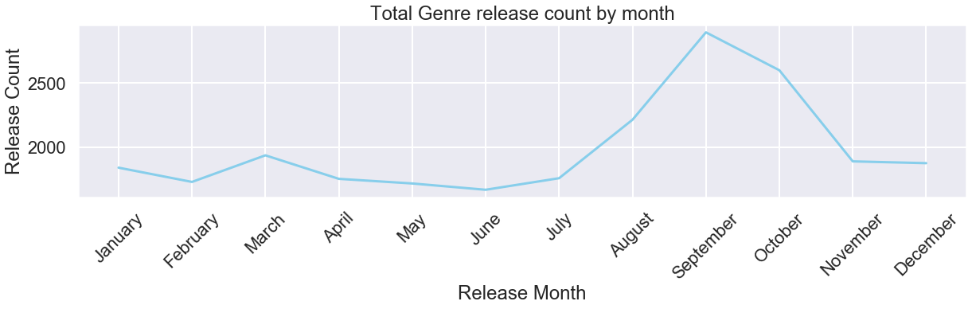
Release Month: Most movies are released in September, also known as “Dump Month”

Slide 8
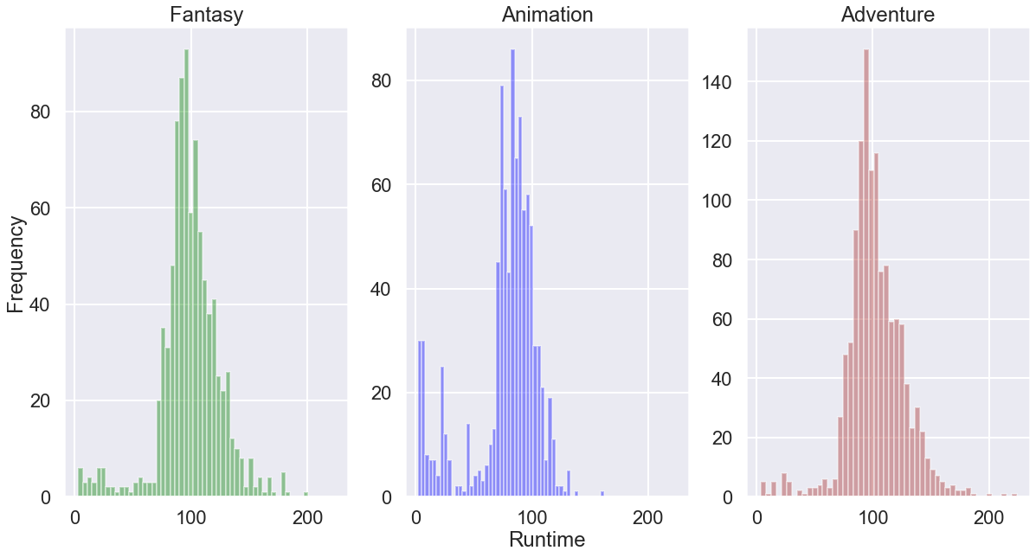
Runtime: Fantasy, Animation, and Adventure movies tend to run for 100 minutes

Slide 9
Recommendations
Competition:
Investigate the operations of production companies such as Universal Pictures and Warner Brothers to optimize your movie production output
Focus on developing large franchises like those owned by Marvel and Lucasfilms in order to maximize total revenue at the box office
Genres:
Avoid genres like Drama, Comedy, and Thriller as these are highly saturated
Focus on developing Fantasy, Adventure, and Animation movies as these return the highest profit
Release Month:
Avoid releasing films in “Dump Months” such as September, as you will have increased competition.
Runtime:
Based on our analysis, the typical Fantasy, Animation, and Adventure genres are typically 90-100 minutes in duration.

Slide 10
Further Analysis
Retrieve data from social media sources (Twitter, Reddit, Facebook, etc) in order to measure the effectiveness of social media marketing on movie success
Retrieve data from online streaming services such as Netflix and Hulu in order to focus on further expansion to online markets
Include Production Countries data (from TMDB) in our analysis in order to assist Microsoft in foreign market expansion

